Slide 1
Data Structures and Algorithms -3 (25CS2103E)
Text Search and Intelligent Query Engine
Team Members
V.VedaPriya 2520030376
M.Thanishka 2520030583
P.Hamsika 2520030586
Under the Esteemed Guidance of
Dr.Yamini Devi
department of CSE

Slide 2
Contents
Abstract
Introduction
Literature survey
Problem Statement and Objectives
Hardware and Software requirements
Results
Conclusion
Future Scope

Slide 3
Abstract
  The Text Search and Intelligent Query Engine is a text-processing system that provides fast searching, spelling correction, and multiple keyword searching. It uses DSA-III algorithms such as KMP, Rabin-Karp, Z Algorithm, Aho-Corasick, Edit Distance, Suffix Array, and LCP Array. The system also compares the performance of different searching algorithms and demonstrates their practical use in text processing.

Slide 4
Introduction
Text searching is widely used in search engines, text editors, and document systems. Basic searching methods can become inefficient when the amount of text increases. Our project uses advanced string algorithms to perform faster searching, correct spelling mistakes, search multiple keywords, and analyze text efficiently.

Slide 5
Literature Survey
Traditional text-search systems commonly use basic pattern matching and indexing techniques. Algorithms such as KMP, Rabin-Karp, and Aho-Corasick provide more efficient searching methods, while Edit Distance is useful for spelling correction. Our project combines these techniques with Suffix Array and LCP to create a single system for different text-processing tasks.

Slide 6
Problem Statement
Searching and analyzing large amounts of text efficiently can be challenging using basic searching techniques. Users may also enter incorrect spellings or search for multiple keywords at the same time. Therefore, there is a need for a system that can perform fast pattern searching, spelling correction, multiple keyword searching, and text analysis using efficient DSA techniques.

Slide 7
Objectives
Implement efficient pattern searching.
Provide spelling correction.
Search multiple keywords simultaneously.
Perform text analysis using Suffix Array and LCP.
Compare the performance of different algorithms.

Slide 8
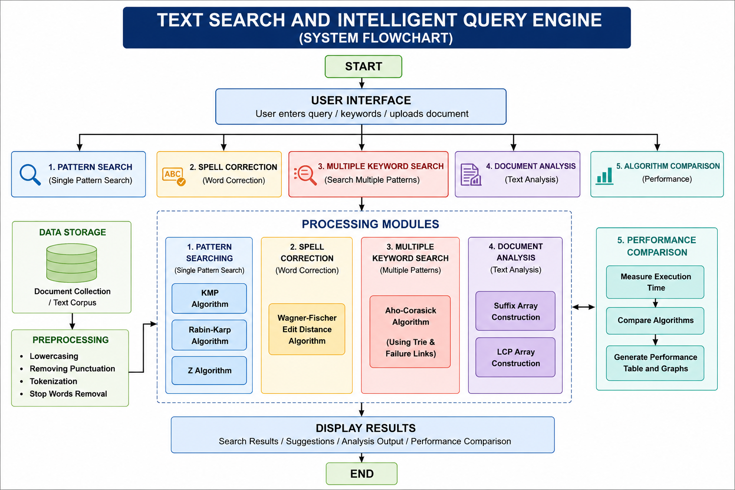
Flow Chart

Slide 9
Results
The system performs pattern searching, spelling correction, multiple keyword searching, and text analysis successfully. KMP, Rabin-Karp, and Z Algorithm are used for pattern searching, Edit Distance for spelling correction, and Aho-Corasick for multiple keywords. The system also compares the execution time of different algorithms.

Slide 10
Hardware and Software requirements
Hardware:
A basic computer with 4 GB RAM, Intel i3 or equivalent processor, and sufficient storage is enough for the project.
Software:
Java is used for algorithm implementation, with HTML, CSS, and JavaScript for the interface. VS Code/IntelliJ can be used for development, along with a web browser.

Slide 11
Conclusion
The project demonstrates the practical application of DSA-III algorithms in text processing. By combining different algorithms, the system provides efficient searching, spelling correction, multiple keyword searching, and text analysis. It also helps compare the practical performance of different algorithm

Slide 12
Future Scope
The project can be extended with AI-based search suggestions, semantic search, plagiarism detection, document ranking, and multilingual support. It can also be improved to handle larger document collections and provide more intelligent search results.

Slide 13
Thank you

